Slide 1
BITS Pilani presentation
K. Venkata Ratnam
Mathematics

Slide 2
Course Number : SS ZC416
Course Title: MATHEMATICAL FOUNDATIONS
FOR DATA SCIENCE
Lecture No. :2

Slide 3
Graph as a matrix

Slide 4
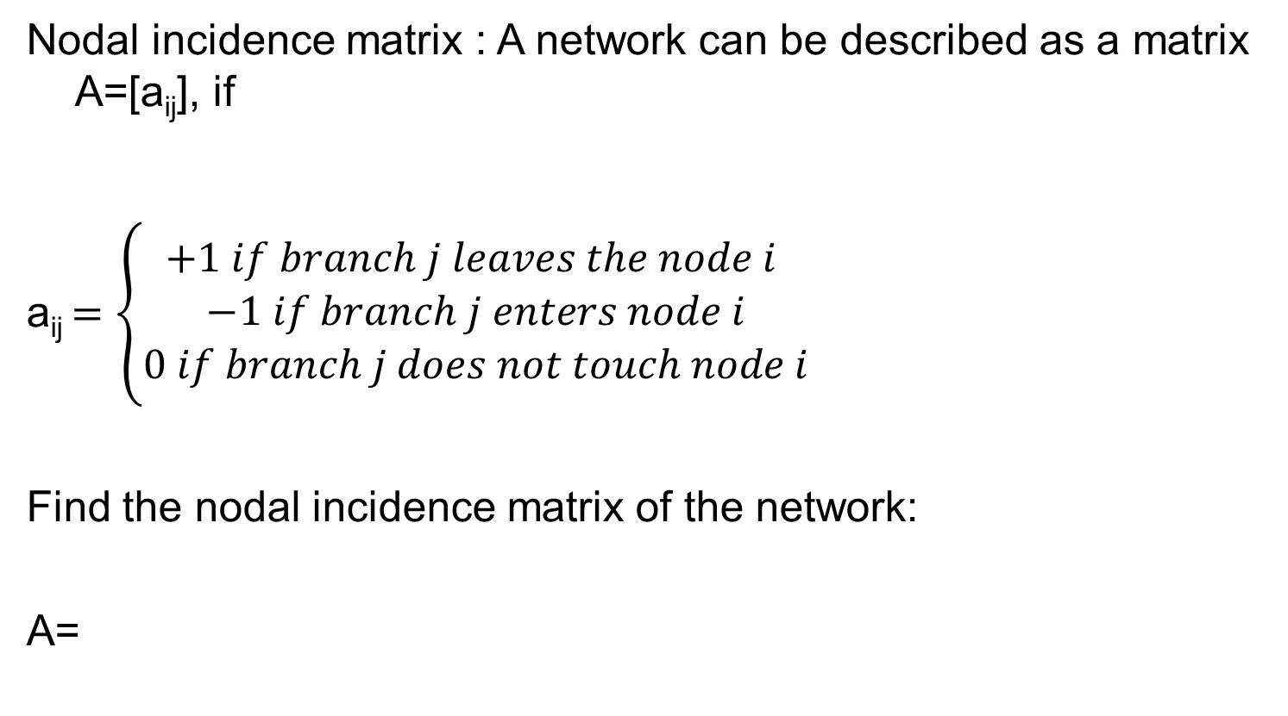
Problem-1
Nodal incidence matrix : A network can be described as a matrix A=[a_{ij}], if
a_{ij} $=\left\{\begin{aligned}+1 if branch j leaves the node i \\ −1 if branch j enters node i \\ 0 if branch j does not touch node i\end{aligned}\right.$
Find the nodal incidence matrix of the network:
A=
-1 1 0 -1 -1
-1 0 0 0
0 0 1 0 1

Slide 5
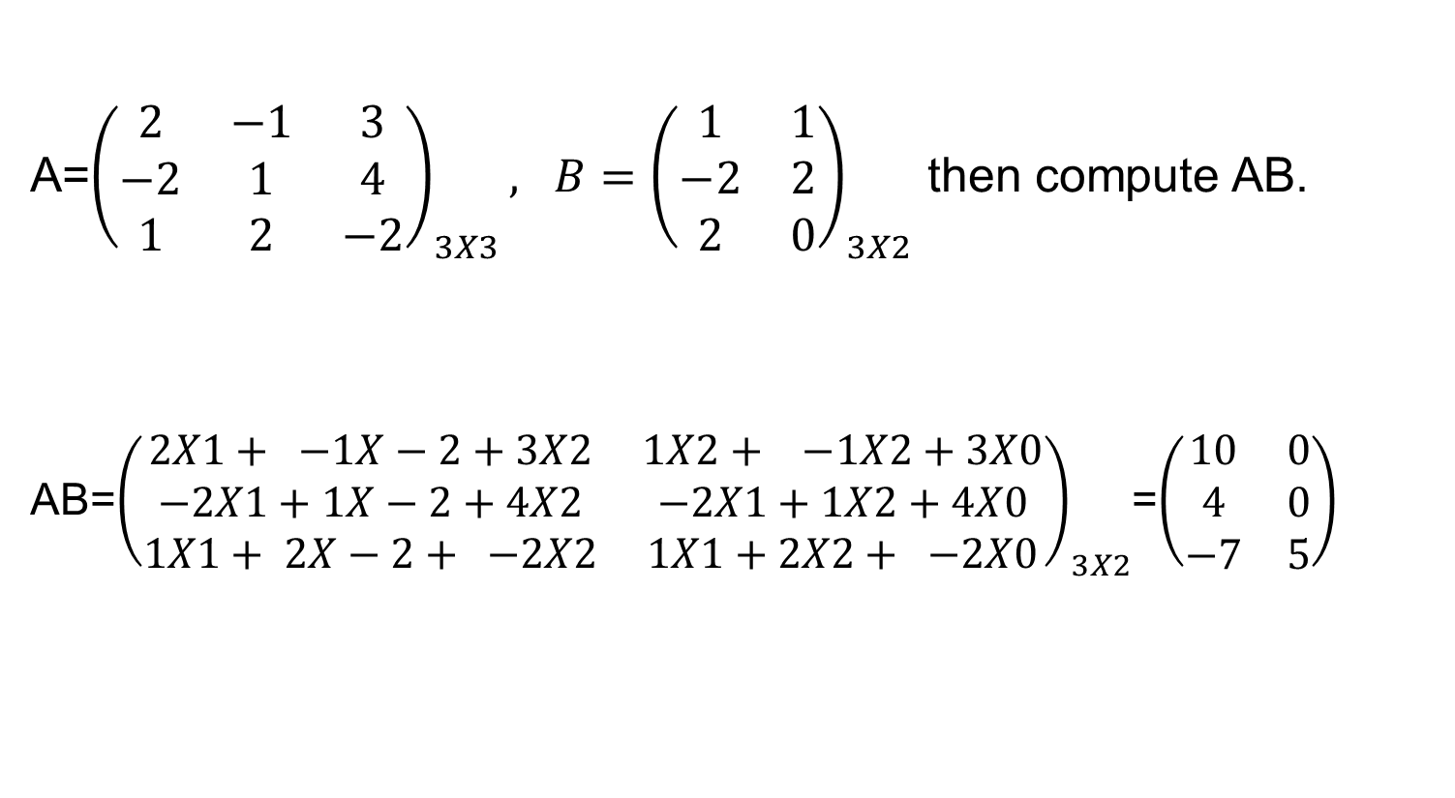
Problem-2 ( Matrix Multiplication)
A=${\left(\begin{matrix}2 & −1 & 3 \\ −2 & 1 & 4 \\ 1 & 2 & −2\end{matrix}\right)}_{3X3}, B={\left(\begin{matrix}1 & 1 \\ −2 & 2 \\ 2 & 0\end{matrix}\right)}_{3X2}$ then compute AB.
AB=${\left(\begin{matrix}2X1+ −1X−2+3X2 & 1X2+ −1X2+3X0 \\ −2X1+1X−2+4X2 & −2X1+1X2+4X0 \\ 1X1+ 2X−2+ −2X2 & 1X1+2X2+ −2X0\end{matrix}\right)}_{3X2}$=$\left(\begin{matrix}10 & 0 \\ 4 & 0 \\ −7 & 5\end{matrix}\right)$

Slide 6
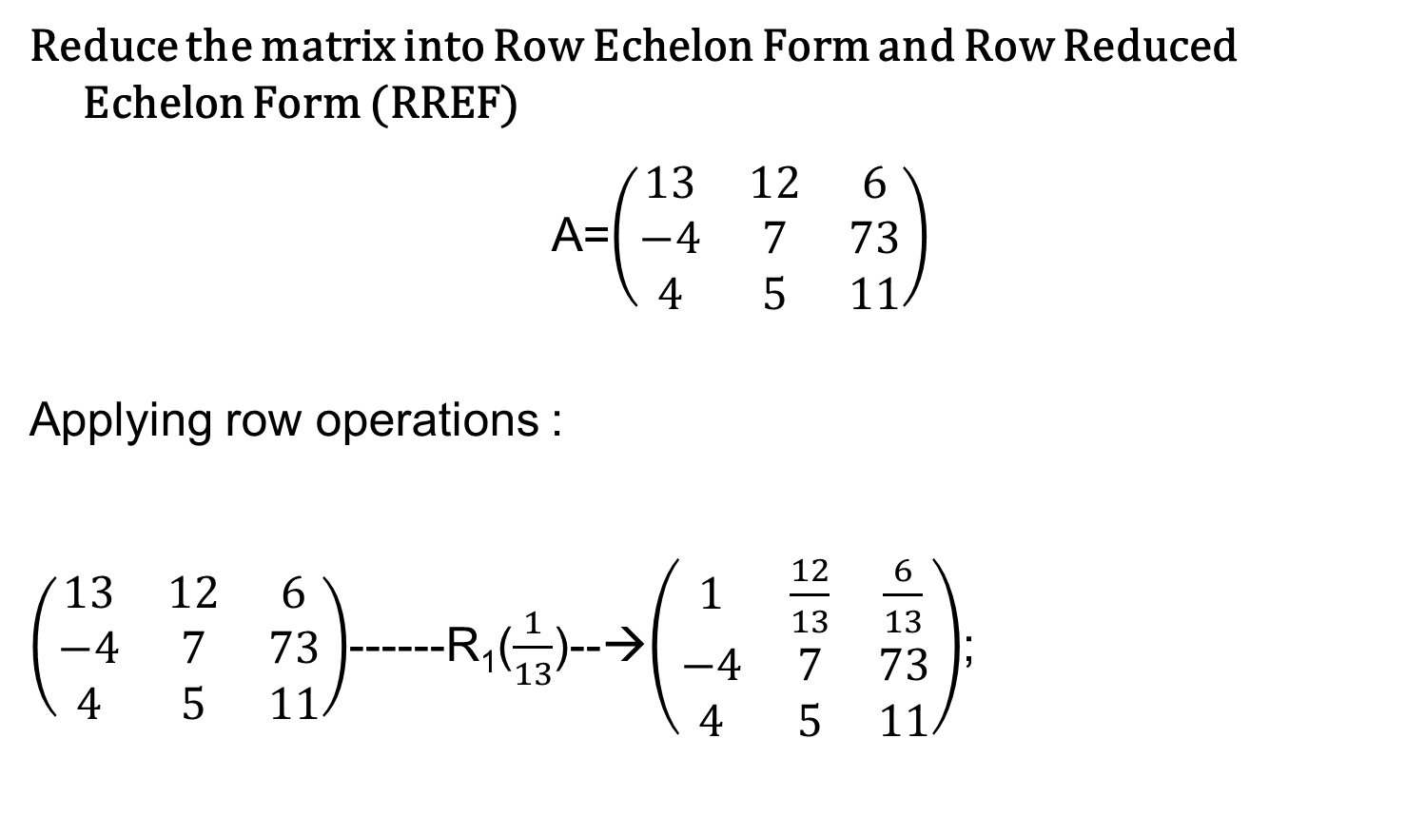
Problem -3
(Row Echelon Form)
Reduce the matrix into Row Echelon Form and Row Reduced Echelon Form (RREF)
A=$\left(\begin{matrix}13 & 12 & 6 \\ −4 & 7 & 73 \\ 4 & 5 & 11\end{matrix}\right)$
Applying row operations :
$\left(\begin{matrix}13 & 12 & 6 \\ −4 & 7 & 73 \\ 4 & 5 & 11\end{matrix}\right)$------R₁($\frac{1}{13}$)--→$\left(\begin{matrix}1 & \frac{12}{13} & \frac{6}{13} \\ −4 & 7 & 73 \\ 4 & 5 & 11\end{matrix}\right)$;

Slide 7
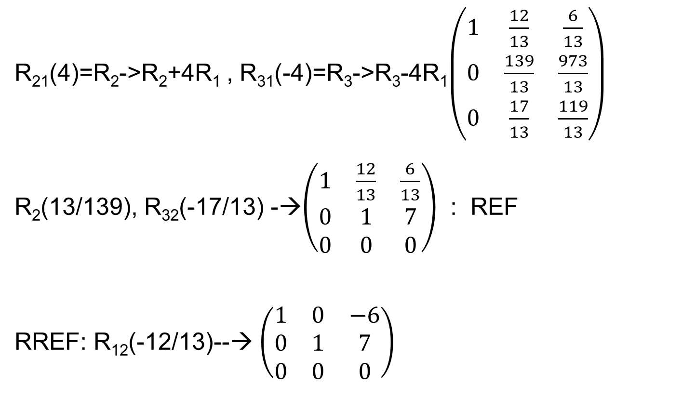
Cont…
R₂₁(4)=R₂->R₂+4R₁ , R₃₁(-4)=R₃->R₃-4R₁$\left(\begin{matrix}1 & \frac{12}{13} & \frac{6}{13} \\ 0 & \frac{139}{13} & \frac{973}{13} \\ 0 & \frac{17}{13} & \frac{119}{13}\end{matrix}\right)$
R₂(13/139), R₃₂(-17/13) -→$\left(\begin{matrix}1 & \frac{12}{13} & \frac{6}{13} \\ 0 & 1 & 7 \\ 0 & 0 & 0\end{matrix}\right)$ : REF
RREF: R₁₂(-12/13)--→ $\left(\begin{matrix}1 & 0 & −6 \\ 0 & 1 & 7 \\ 0 & 0 & 0\end{matrix}\right)$

Slide 8

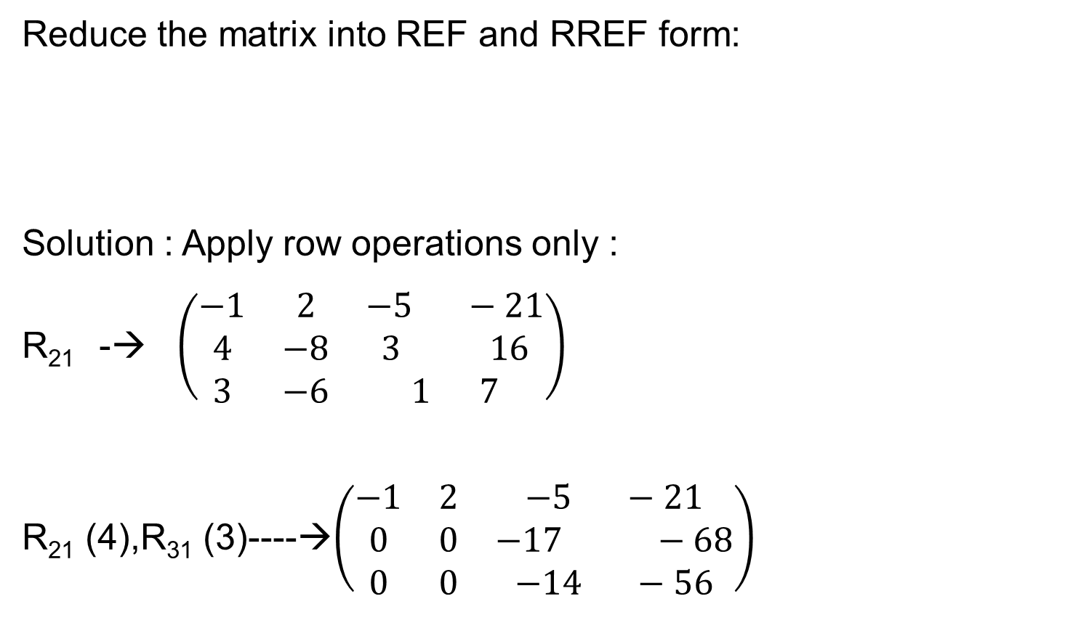
Problem-4
Reduce the matrix into REF and RREF form:
Solution : Apply row operations only :
R₂₁ -→ $\left(\begin{matrix}−1 & 2 & −5 −21 \\ 4 & −8 & 3 16 \\ 3 & −6 & 1 7\end{matrix}\right)$
R₂₁ (4),R₃₁ (3)----→$\left(\begin{matrix}−1 & 2 & −5 −21 \\ 0 & 0 & −17 −68 \\ 0 & 0 & −14 −56\end{matrix}\right)$
$$\left(\begin{matrix}4 & −8 & 3 16 \\ −1 & 2 & −5 −21 \\ 3 & −6 & 1 7\end{matrix}\right)$$

Slide 9

R₂(-1/17), R₃(-1/14)---→$\left(\begin{matrix}−1 & 2 & −5 −21 \\ 0 & 0 & 1 4 \\ 0 & 0 & 1 4\end{matrix}\right)$
R₃₂(-1)---→$\left(\begin{matrix}−1 & 2 & −5 −21 \\ 0 & 0 & 1 4 \\ 0 & 0 & 0 0\end{matrix}\right)$
R₁₂(5)----→ $\left(\begin{matrix}1 & 2 & 0 −1 \\ 0 & 0 & 1 4 \\ 0 & 0 & 0 0\end{matrix}\right)$-----→RREF

Slide 10
Problem-5
What form does 3X3 matrix have if it is symmetric as well as skew symmetric?
Idempotent matrix : A²=A, find 2X2 idempotent matrix
Nilpotent Matrix : A^{n} =0 for some n, give an example of that using 2X2 matrix

Slide 11

Solution:
Zero Matrix only satisfies this criteria.
$\left(\begin{matrix}1 & 0 \\ 0 & 1\end{matrix}\right)$ $\left(\begin{matrix}1 & 0 \\ 0 & 0\end{matrix}\right)$
$\left(\begin{matrix}2 & 2 \\ −2 & −2\end{matrix}\right)$ $\left(\begin{matrix}0 & 0 \\ 1 & 0\end{matrix}\right)$

Slide 12

Problem
Reduce the matrix into RREF:
$$\left(\begin{matrix}2 & 3 & 1 \\ 5 & −2 & 5 \\ \begin{aligned}1 \\ 3\end{aligned} & \begin{aligned}−1 \\ 4\end{aligned} & \begin{aligned}3 \\ −7\end{aligned}\end{matrix} \begin{matrix}−11 \\ −4 \\ \begin{aligned}−3 \\ 2\end{aligned}\end{matrix} \begin{matrix}1 \\ 5 \\ \begin{aligned}3 \\ −7\end{aligned}\end{matrix}\right)$$
Solution :
1 | 0 | 0 | 0 | 0
0 | 1 | 0 | -3 | 0
0 | 0 | 1 | -2 | 1
0 | 0 | 0 | 0 | 0

Slide 13
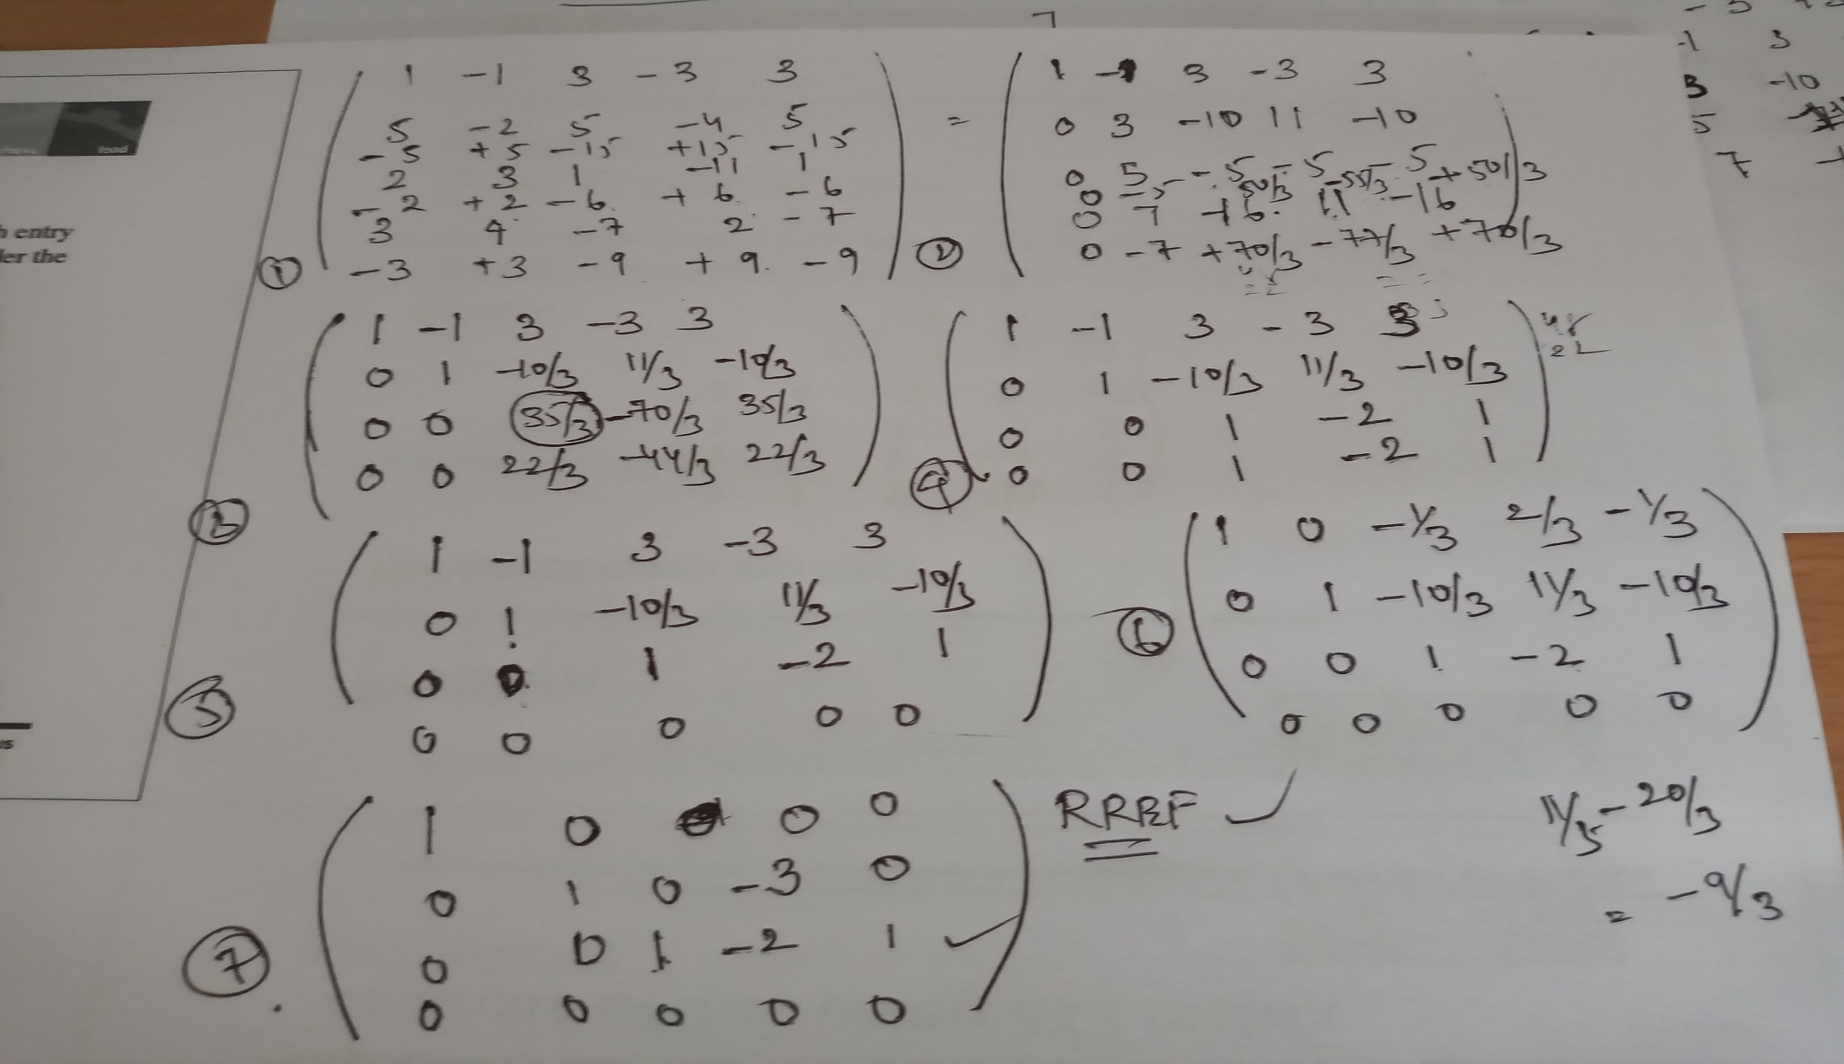
Solution:

Slide 14
Next Lecture :
System of equations : Gauss Elimination method
Inverse : Gauss Jordan method.
Thanking you..

Slide 15
Solving linear systems of equations
Gauss Elimination
Inverse Using Gauss-Jordan

Slide 16
Rank
The number of nonzero rows, r, in the row-reduced coefficient matrix ( row echelon form) R is called the rank of R and also the rank of A.
A---------row operations----→ R ( no of non zeros rows )→ rank

Slide 17
Linear Systems of Equations.
Gauss Elimination
A linear system of m equations in n unknowns is a set of equations of the form

Slide 18
Linear System
The system is called linear because each variable x_{j} appears in the first power only, just as in the equation of a straight line a₁₁,…,a_{nn}, are given numbers, called the coefficients of the system, b_{1,} b₂, …, b_{m}, on the right are also given numbers.
If all the are zero, then (1) is called a homogeneous system.
If at least one is not zero, then (1) is called a nonhomogeneous system.

Slide 19
Definitions
A solution of (1) is a set of numbers x₁,x₂,…,x_{n} that satisfies all the m equations.
A solution vector of (1) is a vector x whose components form a solution of (1).
If the system (1) is homogeneous, it always has at least the trivial solution x₁=0, x₂=0…,x_{n} =0.

Slide 20
Linear system as a Matrix
Matrix Form of the Linear System (1) :
From the definition of matrix multiplication we see that the m equations of (1) may be written as a single vector equation
Ax=b

Slide 21
Linear system as a Matrix

Slide 22
Geometric Interpretation

Slide 23
Note :
r : is the rank of the matrix A, which is the no of nonzero rows in the echelon form : obtained though augmented matrix
m: the number of equations
n: the number of variables
System Ax=b can also be solved through inverse method ( for square matrix) :
X=A⁻¹b (provided A⁻¹ exists)

Slide 24
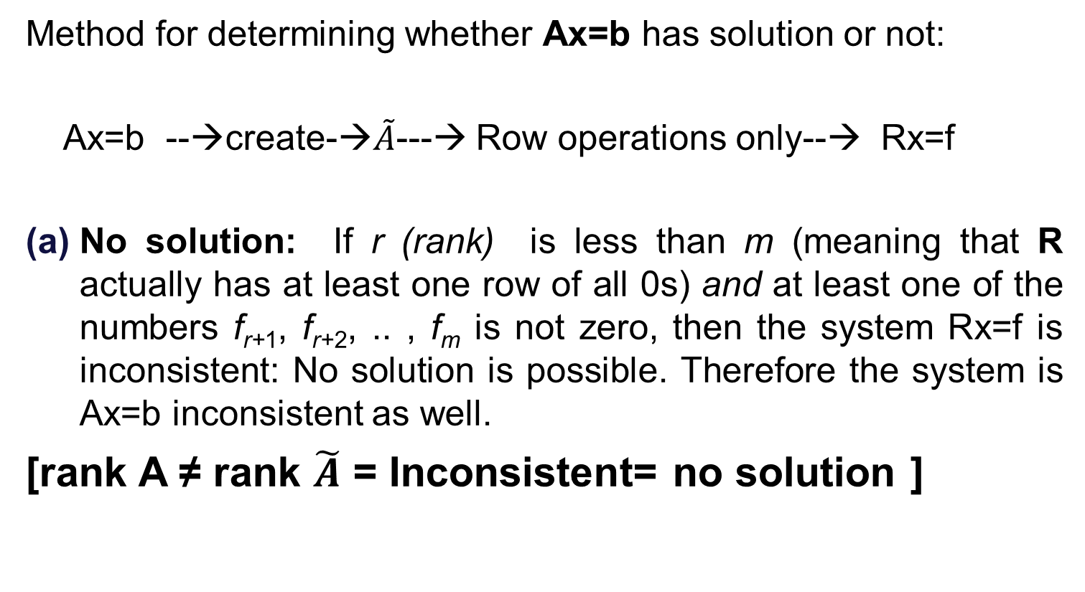
Solving Ax=b
Method for determining whether Ax=b has solution or not:
Ax=b --→create-→$\tilde{A}$---→ Row operations only--→ Rx=f
No solution: If r (rank) is less than m (meaning that R actually has at least one row of all 0s) and at least one of the numbers f_{r+1}, f_{r+2}, .. , f_{m} is not zero, then the system Rx=f is inconsistent: No solution is possible. Therefore the system is Ax=b inconsistent as well.
[rank A ≠ rank $\tilde{A}$ = Inconsistent= no solution ]

Slide 25
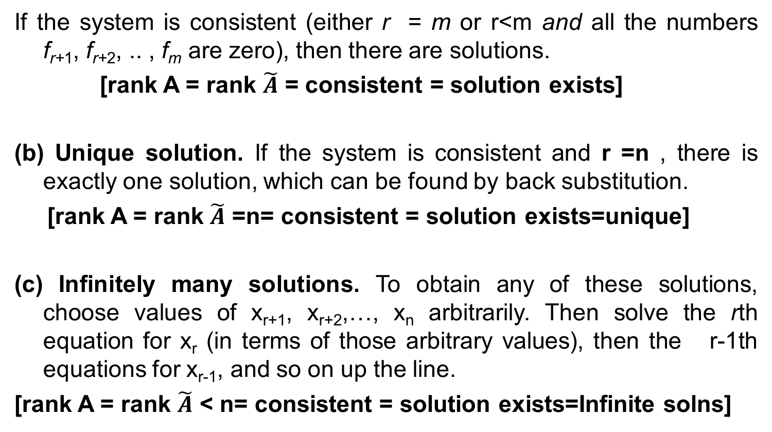
Consistency
If the system is consistent (either r = m or r<m and all the numbers f_{r+1}, f_{r+2}, .. , f_{m} are zero), then there are solutions.
[rank A = rank $\tilde{A}$ = consistent = solution exists]
(b) Unique solution. If the system is consistent and r =n , there is exactly one solution, which can be found by back substitution.
[rank A = rank $\tilde{A}$ =n= consistent = solution exists=unique]
(c) Infinitely many solutions. To obtain any of these solutions, choose values of x_{r+1}, x_{r+2},…, x_{n} arbitrarily. Then solve the rth equation for x_{r} (in terms of those arbitrary values), then the r-1th equations for x_{r-1}, and so on up the line.
[rank A = rank $\tilde{A}$ < n= consistent = solution exists=Infinite solns]

Slide 26
Solutions of linear systems

Slide 27
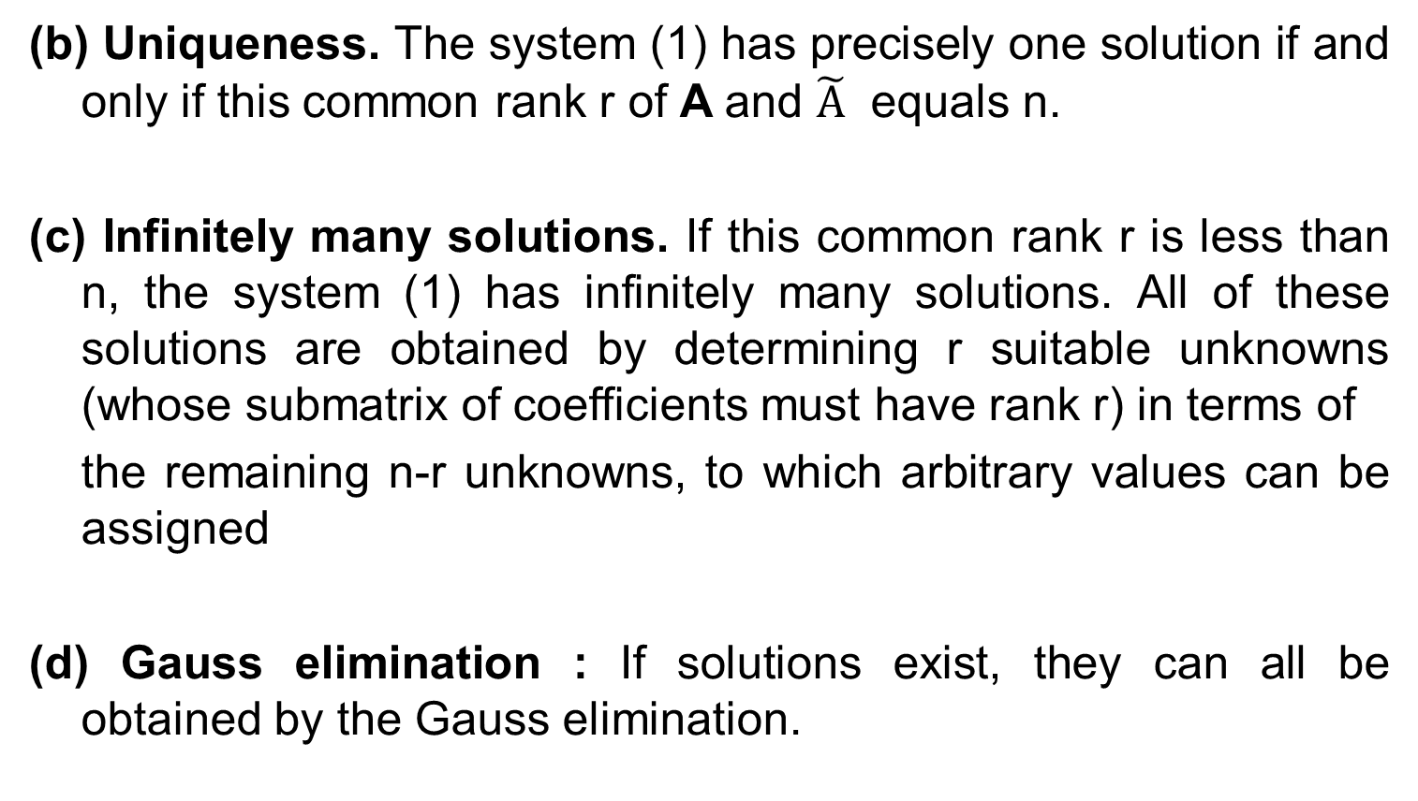
(b) Uniqueness. The system (1) has precisely one solution if and only if this common rank r of A and $\tilde{A}$ equals n.
(c) Infinitely many solutions. If this common rank r is less than n, the system (1) has infinitely many solutions. All of these solutions are obtained by determining r suitable unknowns (whose submatrix of coefficients must have rank r) in terms of
the remaining n-r unknowns, to which arbitrary values can be assigned
(d) Gauss elimination : If solutions exist, they can all be obtained by the Gauss elimination.

Slide 30
Inverse of a Matrix. Gauss–Jordan Elimination
Existence of the Inverse: The inverse of an matrix A⁻¹ exists if and only if rank A=n, thus if and only if det A ≠0 . Hence A is non singular if rank A= n and is singular if rank A< n.
Gauss-Jordan : System Ax= I, create the augmented matrix (with I as the identity matrix) and then apply row transformations (only) to get the inverse.

Slide 31
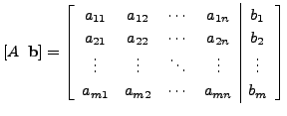
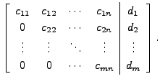
Gauss elimination procedure
Gaussian elimination is a method of solving a linear system (consisting of equations in unknowns) by bringing the augmented matrix to an upper triangular form.
Step 1: Given Ax=b;
Step 2: Prepare the augmented matrix :
Step 3 : Reduce the matrix to Row Echelon Form by using row operations only then it will turn to upper triangular matrix :
Step4: Use backward substitution (start with last nonzero row) to get the solution.

Slide 32
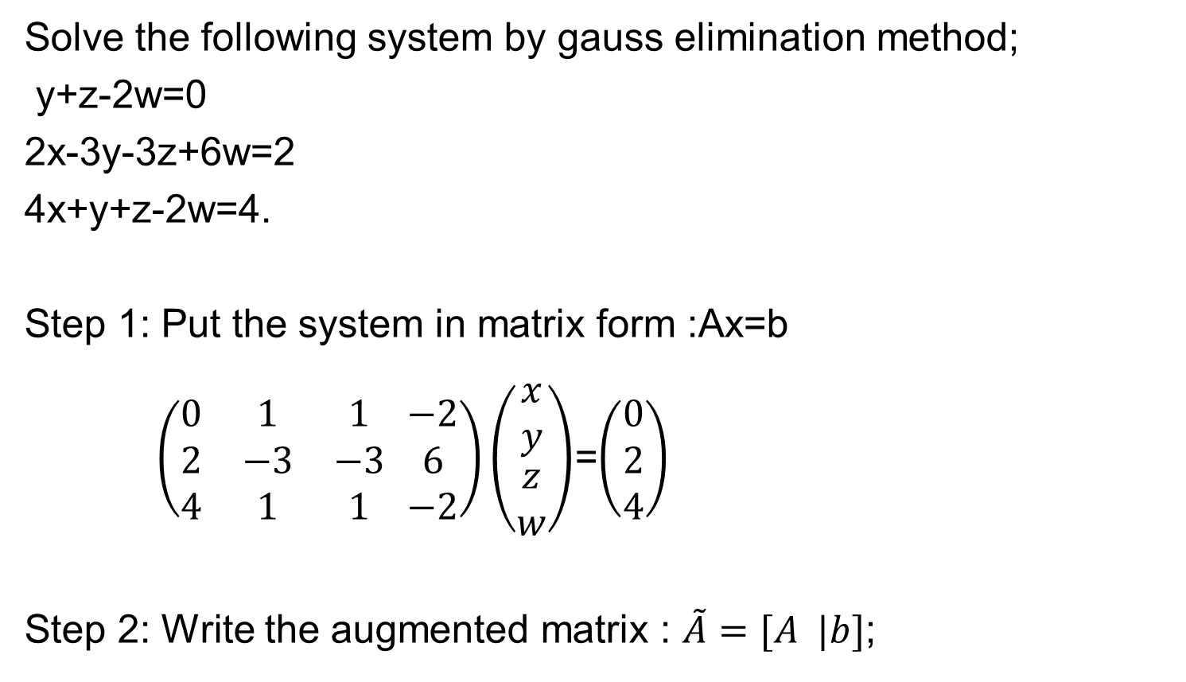
Problem: Gauss Elimination
Solve the following system by gauss elimination method;
y+z-2w=0
2x-3y-3z+6w=2
4x+y+z-2w=4.
Step 1: Put the system in matrix form :Ax=b
$\left(\begin{matrix}0 & 1 & 1 \\ 2 & −3 & −3 \\ 4 & 1 & 1\end{matrix} \begin{matrix}−2 \\ 6 \\ −2\end{matrix}\right)\left(\begin{matrix}x \\ y \\ \begin{aligned}z \\ w\end{aligned}\end{matrix}\right)$=$\left(\begin{matrix}0 \\ 2 \\ 4\end{matrix}\right)$
Step 2: Write the augmented matrix : $\tilde{A}=[A |b]$;

Slide 33
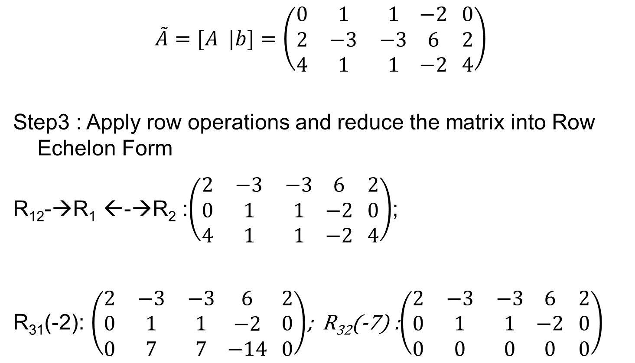
Cont…
$$\tilde{A}=[A |b]=\left(\begin{matrix}0 & 1 & 1 \\ 2 & −3 & −3 \\ 4 & 1 & 1\end{matrix} \begin{matrix}−2 \\ 6 \\ −2\end{matrix} \begin{matrix}0 \\ 2 \\ 4\end{matrix}\right)$$
Step3 : Apply row operations and reduce the matrix into Row Echelon Form
R₁₂-→R₁ ←-→R₂ :$\left(\begin{matrix}2 & −3 & −3 \\ 0 & 1 & 1 \\ 4 & 1 & 1\end{matrix} \begin{matrix}6 \\ −2 \\ −2\end{matrix} \begin{matrix}2 \\ 0 \\ 4\end{matrix}\right)$;
R₃₁(-2): $\left(\begin{matrix}2 & −3 & −3 \\ 0 & 1 & 1 \\ 0 & 7 & 7\end{matrix} \begin{matrix}6 \\ −2 \\ −14\end{matrix} \begin{matrix}2 \\ 0 \\ 0\end{matrix}\right)$; R₃₂(-7) :$\left(\begin{matrix}2 & −3 & −3 \\ 0 & 1 & 1 \\ 0 & 0 & 0\end{matrix} \begin{matrix}6 \\ −2 \\ 0\end{matrix} \begin{matrix}2 \\ 0 \\ 0\end{matrix}\right)$

Slide 34
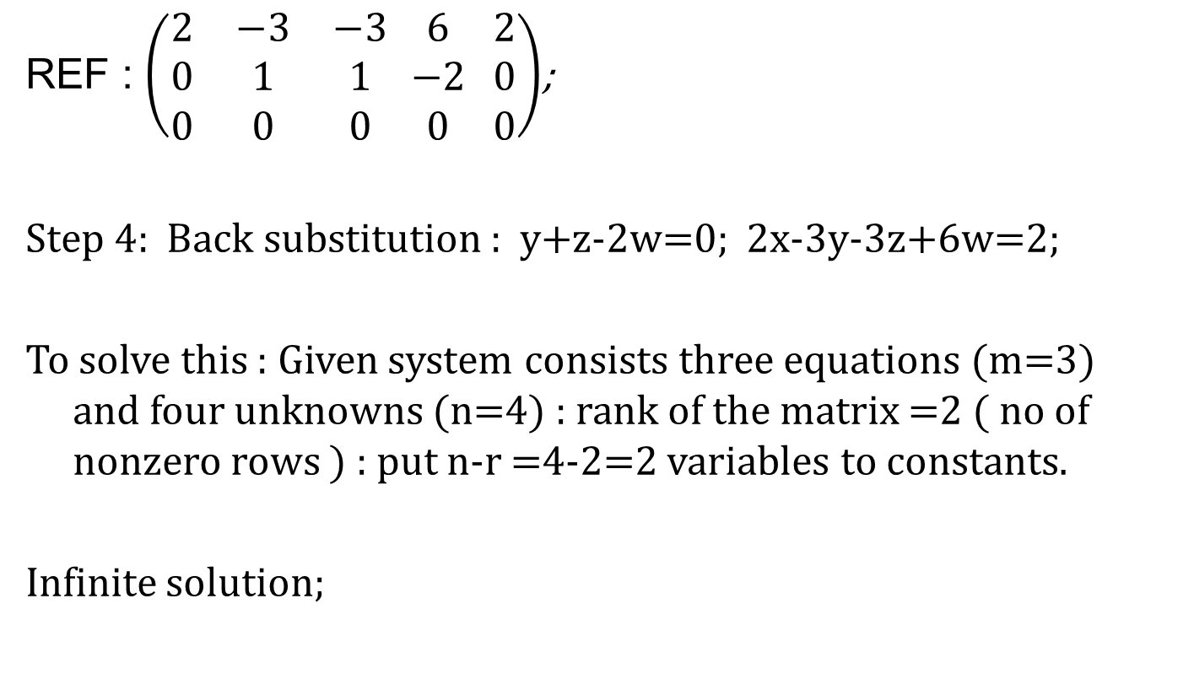
Cont..
REF : $\left(\begin{matrix}2 & −3 & −3 \\ 0 & 1 & 1 \\ 0 & 0 & 0\end{matrix} \begin{matrix}6 \\ −2 \\ 0\end{matrix} \begin{matrix}2 \\ 0 \\ 0\end{matrix}\right)$;
Step 4: Back substitution : y+z-2w=0; 2x-3y-3z+6w=2;
To solve this : Given system consists three equations (m=3) and four unknowns (n=4) : rank of the matrix =2 ( no of nonzero rows ) : put n-r =4-2=2 variables to constants.
Infinite solution;

Slide 35
Cont..
That is generally last two variable are constant( any value) say z= s, w=t
then y=-s+2w=-s+2t;
2x=2+3y+3s-6w=2-3s+6t+3s-6t;
2x=2; x=1; y=-s+2t;
One solution is x=1, y=1, z=1, w=1 by keeping s=1 and t=1

Slide 36
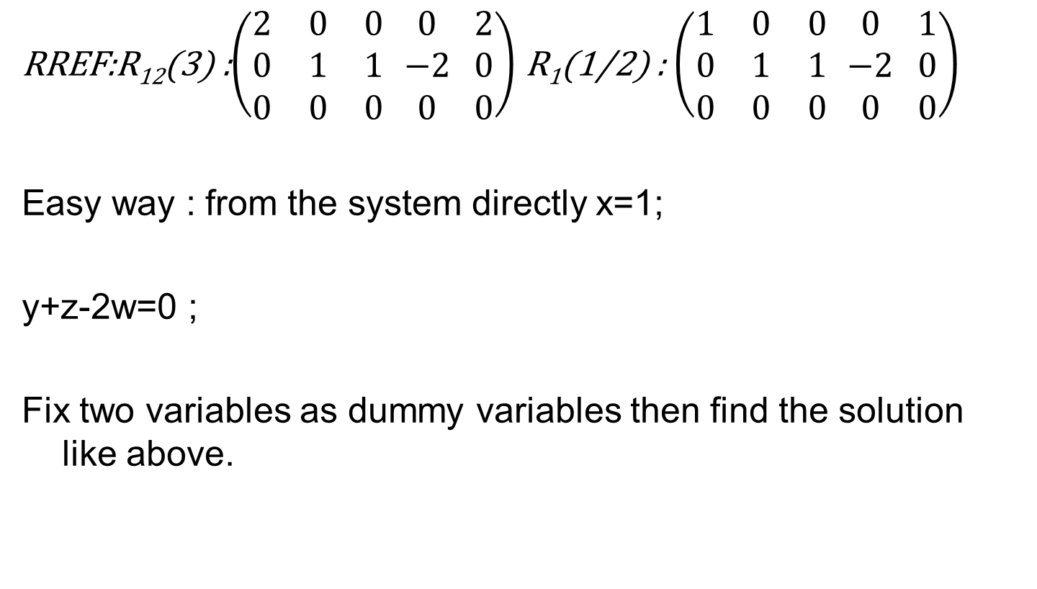
Cont…
RREF:R₁₂(3) :$\left(\begin{matrix}2 & 0 & 0 \\ 0 & 1 & 1 \\ 0 & 0 & 0\end{matrix} \begin{matrix}0 \\ −2 \\ 0\end{matrix} \begin{matrix}2 \\ 0 \\ 0\end{matrix}\right)$ R₁(1/2) : $\left(\begin{matrix}1 & 0 & 0 \\ 0 & 1 & 1 \\ 0 & 0 & 0\end{matrix} \begin{matrix}0 \\ −2 \\ 0\end{matrix} \begin{matrix}1 \\ 0 \\ 0\end{matrix}\right)$
Easy way : from the system directly x=1;
y+z-2w=0 ;
Fix two variables as dummy variables then find the solution like above.

Slide 37

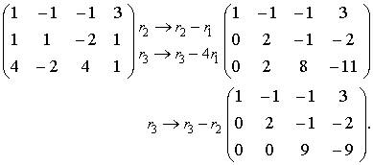
Problem-2
Use Gaussian elimination to solve the following homogeneous system of equations.
By elementary transformations, the coefficient matrix can be reduced to the row echelon form

Slide 38

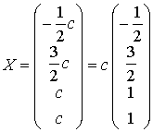
The rank of this matrix equals r=3, and so the system with four unknowns (n-r=4-3=1) has an infinite number of solutions, depending on one free variable. If we choose x₄ as the free variable and set x₄=c, then the leading unknowns have to be expressed through the parameter c. The above matrix corresponds to the following homogeneous system

Slide 39
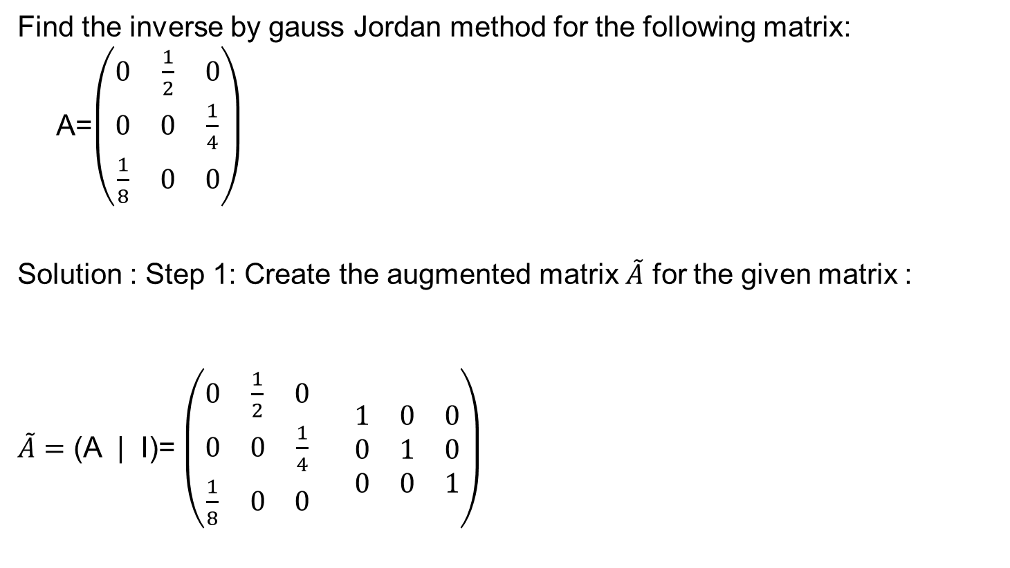
Problem-3
(Gauss Jordan )
Find the inverse by gauss Jordan method for the following matrix: A=$\left(\begin{matrix}0 & \frac{1}{2} & 0 \\ 0 & 0 & \frac{1}{4} \\ \frac{1}{8} & 0 & 0\end{matrix}\right)$
Solution : Step 1: Create the augmented matrix $\tilde{A}$ for the given matrix :
$\tilde{A}=$ (A | I)= $\left(\begin{matrix}0 & \frac{1}{2} & 0 \\ 0 & 0 & \frac{1}{4} \\ \frac{1}{8} & 0 & 0\end{matrix} \begin{matrix}1 & 0 & 0 \\ 0 & 1 & 0 \\ 0 & 0 & 1\end{matrix}\right)$

Slide 40
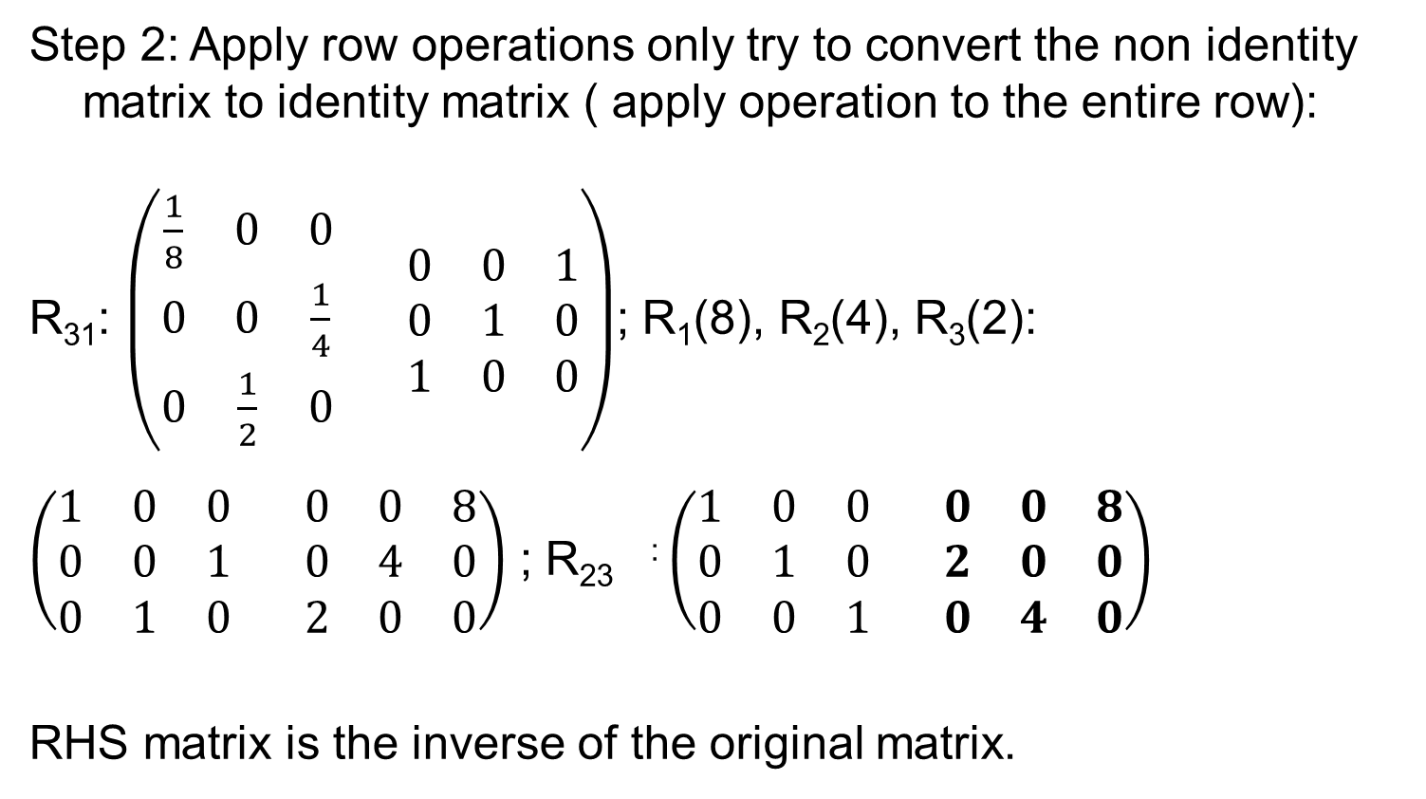
Cont..
Step 2: Apply row operations only try to convert the non identity matrix to identity matrix ( apply operation to the entire row):
R₃₁: $\left(\begin{matrix}\frac{1}{8} & 0 & 0 \\ 0 & 0 & \frac{1}{4} \\ 0 & \frac{1}{2} & 0\end{matrix} \begin{matrix}0 & 0 & 1 \\ 0 & 1 & 0 \\ 1 & 0 & 0\end{matrix}\right)$; R₁(8), R₂(4), R₃(2):
$\left(\begin{matrix}1 & 0 & 0 \\ 0 & 0 & 1 \\ 0 & 1 & 0\end{matrix} \begin{matrix}0 & 0 & 8 \\ 0 & 4 & 0 \\ 2 & 0 & 0\end{matrix}\right)$ ; R₂₃ : $\left(\begin{matrix}1 & 0 & 0 \\ 0 & 1 & 0 \\ 0 & 0 & 1\end{matrix} \begin{matrix}0 & 0 & 8 \\ 2 & 0 & 0 \\ 0 & 4 & 0\end{matrix}\right)$
RHS matrix is the inverse of the original matrix.

Slide 41
Practice problems
Solve the system using gauss elimination method:
10x+4y-2z=14
-3w-15x+y+2z=0
w+x+y=6
8w-5x+5y-10z=26;
Solution : 1 0 0 0 0
0 1 0 0 4
0 0 1 0 1
0 0 0 1 2

Slide 42

Problem
Find the inverse by gauss-Jordon :
$$\left(\begin{matrix}−4 & 0 & 0 \\ 0 & 8 & 13 \\ 0 & 3 & 5\end{matrix} \right)$$
Prove that (A⁻¹)⁻¹=A

Slide 43
